Slide 1
Sentiment Analysis of Movie Reviews
Xuejun Chen, Wanting Tan, Shuangshuang Xu

Slide 2
Content:
Project Introduction
Challenges
Approaches
Future Plan

Slide 3
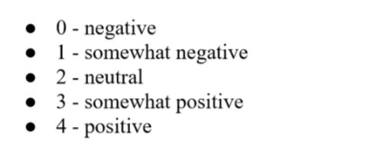
Project Introduction
Goal: Classify the Rotten Tomatoes movie review dataset into 5 groups (negative to positive)
This is a sentiment analysis problem: determine the attitude of a writer with respect to overall contextual polarity of a document.
The five classes corresponding to sentiments:

Slide 4
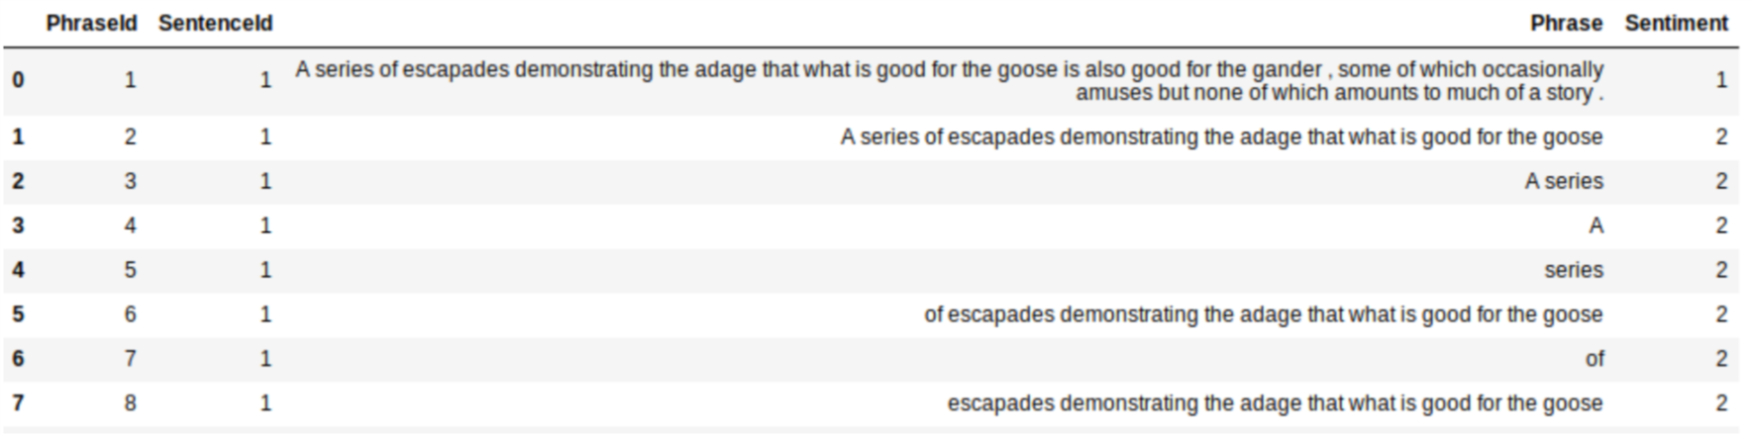
Challenges
It’s a multi-class classification rather than binary classification
Each Sentence has been parsed into many phrases by the Stanford parser
Purpose: to consider sentiment of sentence structure rather than single word
We have to deal with sentence negation, sarcasm, terseness, language ambiguity, etc

Slide 5
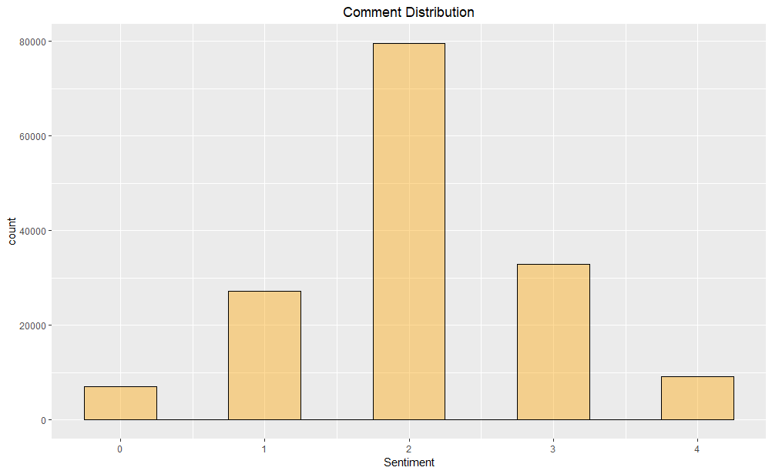
Approaches
KNN
Logistic Regression
Naive Bayes
Support Vector Machines
LSTM

Slide 6
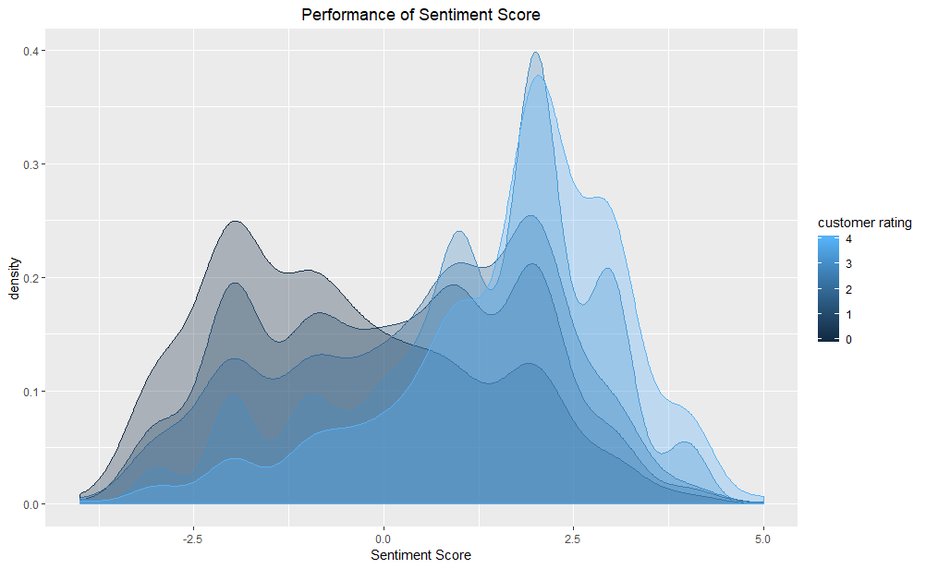
Model 1: KNN + AFINN
Procedure:
Only keep complete sentences and calculate sentiment score for each sentence (AFINN lexicon)
Based on sentiment scores, classify reviews into 5 groups using KNN and cross validation
Accuracy=33%
Problems:
Low accuracy
Waste data (some sentences don’t have sentiment score)

Slide 7
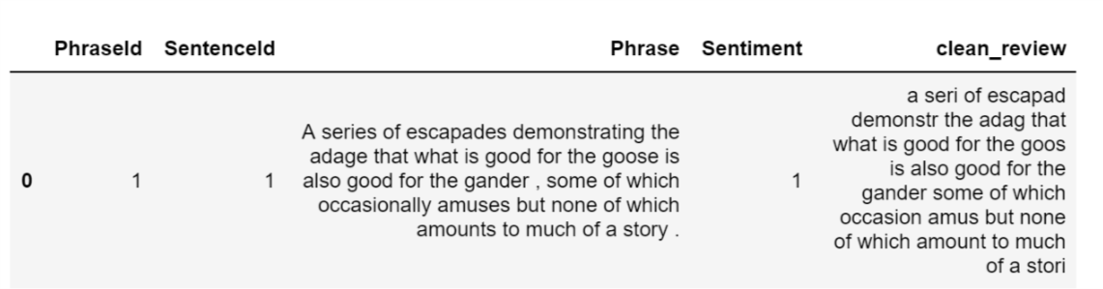
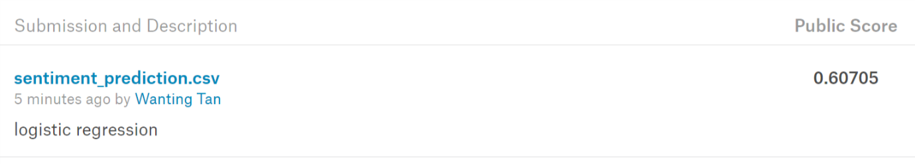
Model 2: Logistic Regression + TF-IDF
Data Processing
Remove punctuation marks
Convert data to lowercase
Lemmatize the data
Build TF-IDF matrix and fit logistic regression using multiclass strategy
Accuracy: 60.71%

Slide 8
Model 3: Naive Bayes + TF-IDF
Data Processing
CountVectorizer()
Tf–idf term weighting
Fit a Multinomial Naive Bayes Model
Accuracy: 57.88%

Slide 9
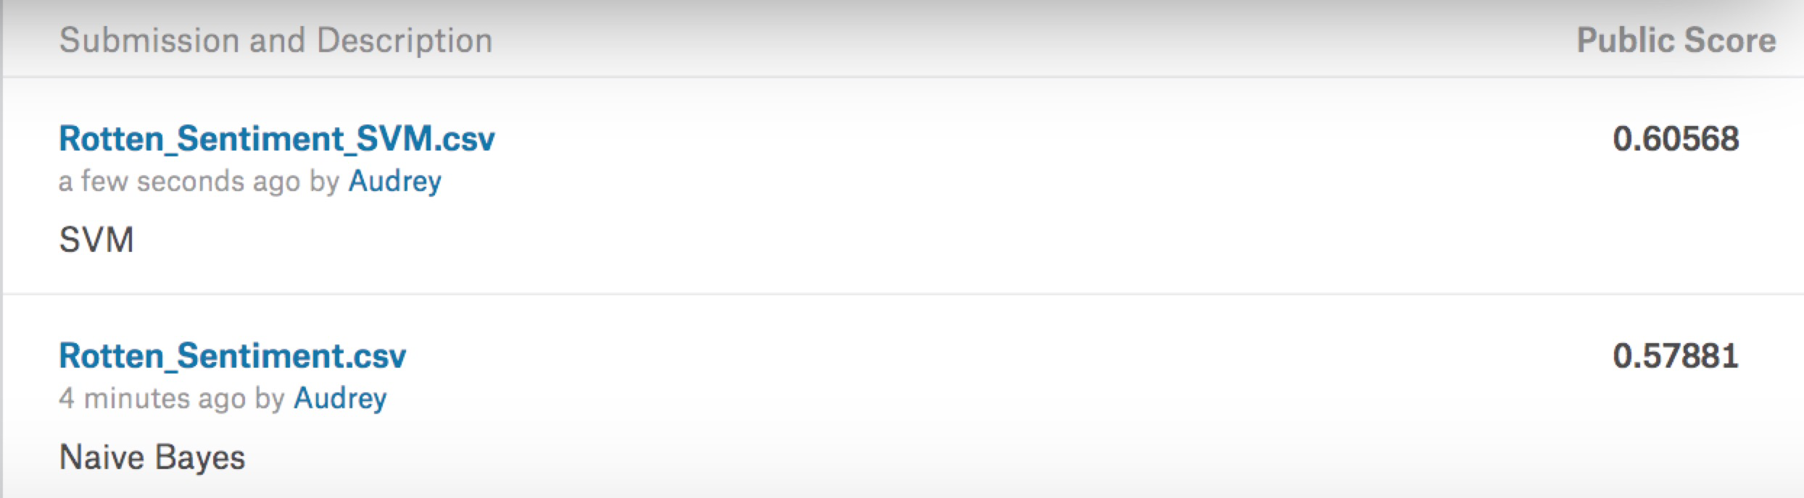
Model 4: SVM + TF-IDF
Same processing procedures
SVM performs better

Slide 10
Model 5: LSTM (Long Short Term Memory network)
Data Processing
Lower case
Stemmed word
Word index in vocabulary
Validation set approach, categorical cross entropy
LSTM model, 3 layers, activation function: softmax, ReLU
Accuracy: 59.45%

Slide 11
Future plan
Consider bi-gram and tri-gram into models
Add K-fold cross validation
Preprocess: pattern or TextBlog package
SentenceID as variable
Try boosting algorithm: Random Forest and Adaboost

